Slide 1
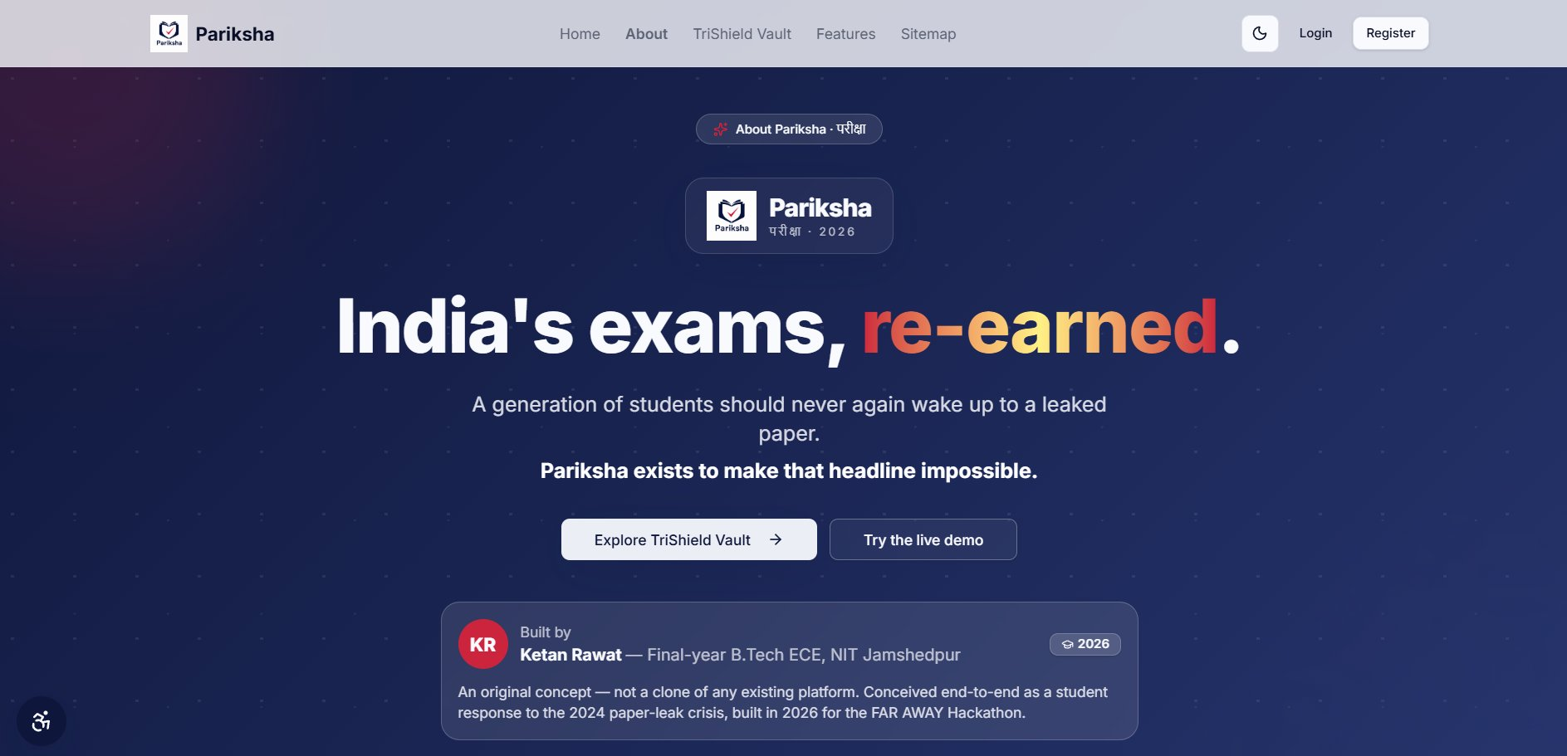

Pariksha
परीक्षा · 2026
India's exams,
re-earned.
A generation of students should never again
wake up to a leaked paper.
Pariksha exists to make that headline impossible.
Explore TriShield Vault →
Try the website by yourself
KR
Ketan Rawat — Final-year B.Tech ECE, NIT Jamshedpur
An original concept · not a clone · FAR AWAY Hackathon 2026
Notes:
Motto: India's exams, re-earned. Both buttons are live clickable links. Demo password: Demo@1234

Slide 2

Pariksha
Home
TriShield Vault
Features
Demo
PROBLEM STATEMENT
A decade of paper leaks.
70+ incidents · 15 states · 1.7 crore students' futures disrupted
2026
2024
2017
2013–23
NEET-UG Cancelled
Triple Leak Year
SSC Scandal
Vyapam Scam
Three national exams leaked in one year. NEET paper reached coaching networks before the exam started. UGC-NET appeared on the dark web the night before — cancelled next morning. BPSC paper on Telegram an hour before start. Supreme Court intervened. Millions of students re-examined. No structural change.
Papers leaked through insiders inside the official printing chain. Students who had spent years and lakhs preparing found it meaningless. Protests across 20 states. SSC chairman summoned. Inquiry ordered. The root cause — one person with access — was never addressed.
A decade-long racket fixing government job and medical admission exams in Madhya Pradesh. Impersonators placed in halls, answer sheets manipulated. 2,500 arrested. 55 deaths linked to the case. Ran ten years before anyone exposed it.
Kota syndicate circulated the paper via WhatsApp before 6am on exam day. NTA cancelled it nine days later. Five students died. Akanksha Chaturvedi left a note saying she could not be sure she would score the same again. NTA chief removed. CBI investigation opened. Re-exam scheduled June 21. Nothing fixed at the root.
Root cause — every single time:
One person with enough access had the power to act alone. Pariksha makes that structurally, mathematically impossible.

Slide 3
They didn't fail.
The system did.
✕
✕
✕
Pradeep Manich, 23
Akanksha Chaturvedi, 20
Maithili Sonwane, 18
His father is a daily wage labourer from Jhunjhunu, Rajasthan. The family sold agricultural land to fund his NEET preparation and hostel costs in Sikar. This was his third attempt. He had given the exam on May 3 feeling it had gone well. When the cancellation was announced he died by suicide. He never got to see his score.
From a small town in Madhya Pradesh. She had walked out of the exam on May 3 expecting a score above 650 — enough for a government medical college. Her family found a note tucked inside one of her study books. It read: I had high hopes of scoring good marks, but now there is no guarantee I will perform just as well again. She had done nothing wrong.
From Latur, Maharashtra — a district that has produced thousands of NEET aspirants over decades and carries enormous pressure around medical admissions. She was 18. The cancellation triggered severe mental distress that her family watched her struggle through alone. She is one of at least five student deaths confirmed to be directly linked to the NEET 2026 cancellation.
Pariksha exists so no student ever wakes up to this headline again.
If you are struggling: iCall 9152987821 (free, confidential)

Slide 4
Pariksha
Home
TriShield Vault
Features
Demo
SOLUTION
Not a proctoring add-on.
The examination authority itself — end-to-end, from registration to certificate.
1
2
3
4
5
6
Registration
Payment
Admit Card
Lockdown Exam
Result
Certificate
Name, email, phone, and category collected. Aadhaar number hashed with SHA-256 in your browser before it reaches us — we never store the raw number. A live webcam photo is captured right there in the browser. No file upload. No fake photos.
Stripe integration in test mode. Fees differ by category — General, OBC, and SC-ST each have separate amounts set by the exam authority. Pay once, registration confirmed instantly.
Auto-generated exactly 3 days before the exam date. Contains your live registration photo, full name, seat number, exam centre address, reporting time, and a working QR code. Delivered to your notification section. Download as PDF, print and carry.
Fullscreen is mandatory — deny it and the exam does not start. Face verified live against your registration photo before entry. Tab switching, copy-paste, right-click, and devtools all blocked and logged. Integrity score updates on the invigilator screen in real time throughout.
Evaluated the moment you submit. Negative marking applied automatically. Score, rank among all candidates who gave that exam, percentile, and section-wise breakdown all calculated within minutes. Result email sent to your registered address immediately.
Signed with Ed25519 cryptographic signature. Unique certificate ID in the format CERT-PKSH-XXXXXX. QR code links to a public verification page — anyone can scan it and confirm the certificate is genuine without logging in to Pariksha.
Five roles: Candidate · Invigilator · Institute · Admin · Superadmin · Row Level Security on every database table

Slide 5


Pariksha
Home
TriShield Vault
Features
Demo
KEY FEATURES
Six features. Every failure mode closed.
INNOVATION · IMPACT · COMPLETENESS
UNIQUE
SECURE
AI
TriShield Vault
Lockdown Exam Browser
AI Face Proctoring
3-party cryptographic custody.
No single person can read or
modify a sealed paper. Ever.
Fullscreen mandatory. Tab-switch,
copy-paste, devtools, right-click
all blocked and logged.
face-api.js at entry + re-check
every 5 min. Multiple faces →
critical alert, instant.
REALTIME
24×7
VERIFIED
Live Integrity Scoring
SHA-256 Leak Detector
Ed25519 Certificates
0–100 per candidate, WebSocket.
Invigilator grid updates without
any page refresh needed.
Edge Function every 60 seconds.
Any hash mismatch → CRITICAL
alert, automatic, no human.
Signed certificate with unique ID
and QR code. Public verification
page — anyone can check.

Slide 6



CORE INNOVATION · UNIQUE TO PARIKSHA
TriShield Vault
Three-party cryptographic paper custody. No single person can read or modify a sealed paper. Ever.
Fragment 1
Fragment 2
Fragment 3
Institute
Platform Server
Auditor
Derived from the institute's private passkey using PBKDF2. Never transmitted to any server. Never stored anywhere in the database. Exists only in the institute's browser memory during active use. If the passkey is lost the paper cannot be decrypted for editing — ever. This is intentional and by design.
Stored in a server-side environment variable. Never returned in any API response to any client. No frontend code ever receives it. No database column holds it. Even a developer with full database access cannot see it. It exists only in server memory and never travels over any network.
Held by an independently assigned third party with no connection to the institute or the exam content. Cannot be pressured by either the institute or the Pariksha admin. Even if the institute and admin collude, they still cannot open the paper without this fragment. Creates an accountability layer that neither party controls.
ANY 2 OF 3 → FULL AES-256-GCM KEY → DECRYPTED QUESTIONS

Slide 7
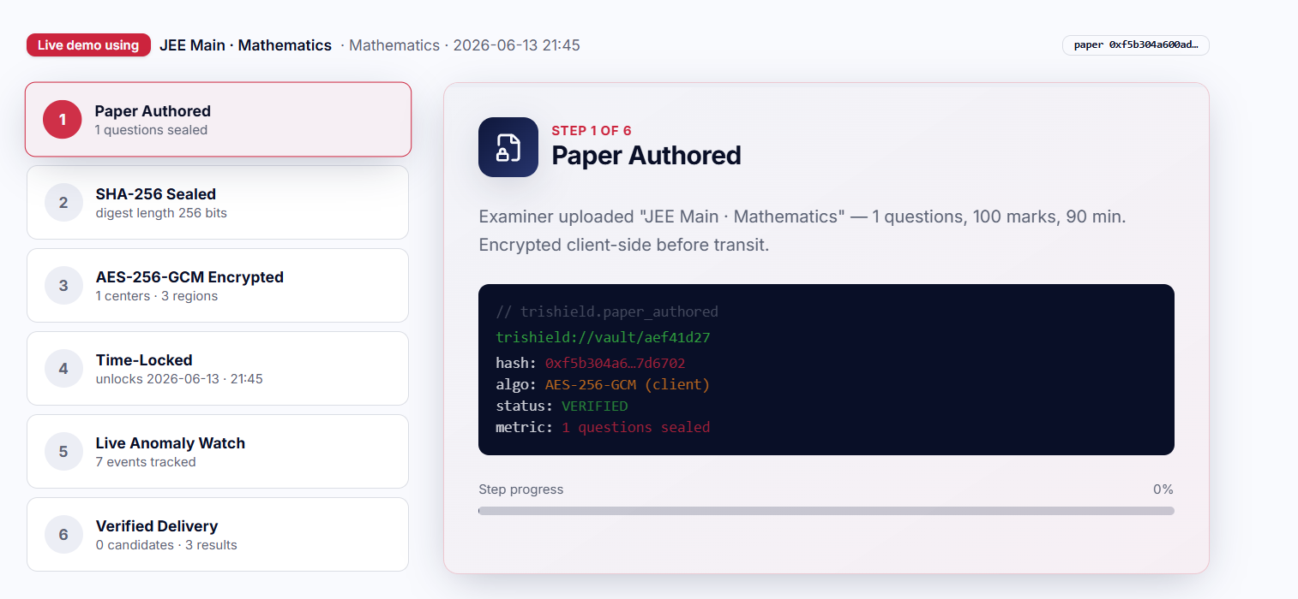
Pariksha
Home
TriShield Vault
Features
Demo
SECURITY
Every attack vector. Every one — closed.
Attack Vector
Existing Platform
Pariksha TriShield
Corrupt institute edits paper
Possible — direct DB
Impossible — admin approval + immutable log
Admin reads sealed questions
Possible — credentials
Impossible — no institute passkey on server
DB attacker steals questions
Gets plaintext data
AES-256-GCM blob — zero key material in DB
Institute + admin collude
Undetectable
Immutably logged + auditor Fragment 3
Silent DB tampering
Hours undetected
SHA-256 mismatch → CRITICAL < 60 seconds
Open TriShield and play 60 sec demo to know the flow→
TriShield Vault — live 6-step demo

Slide 8
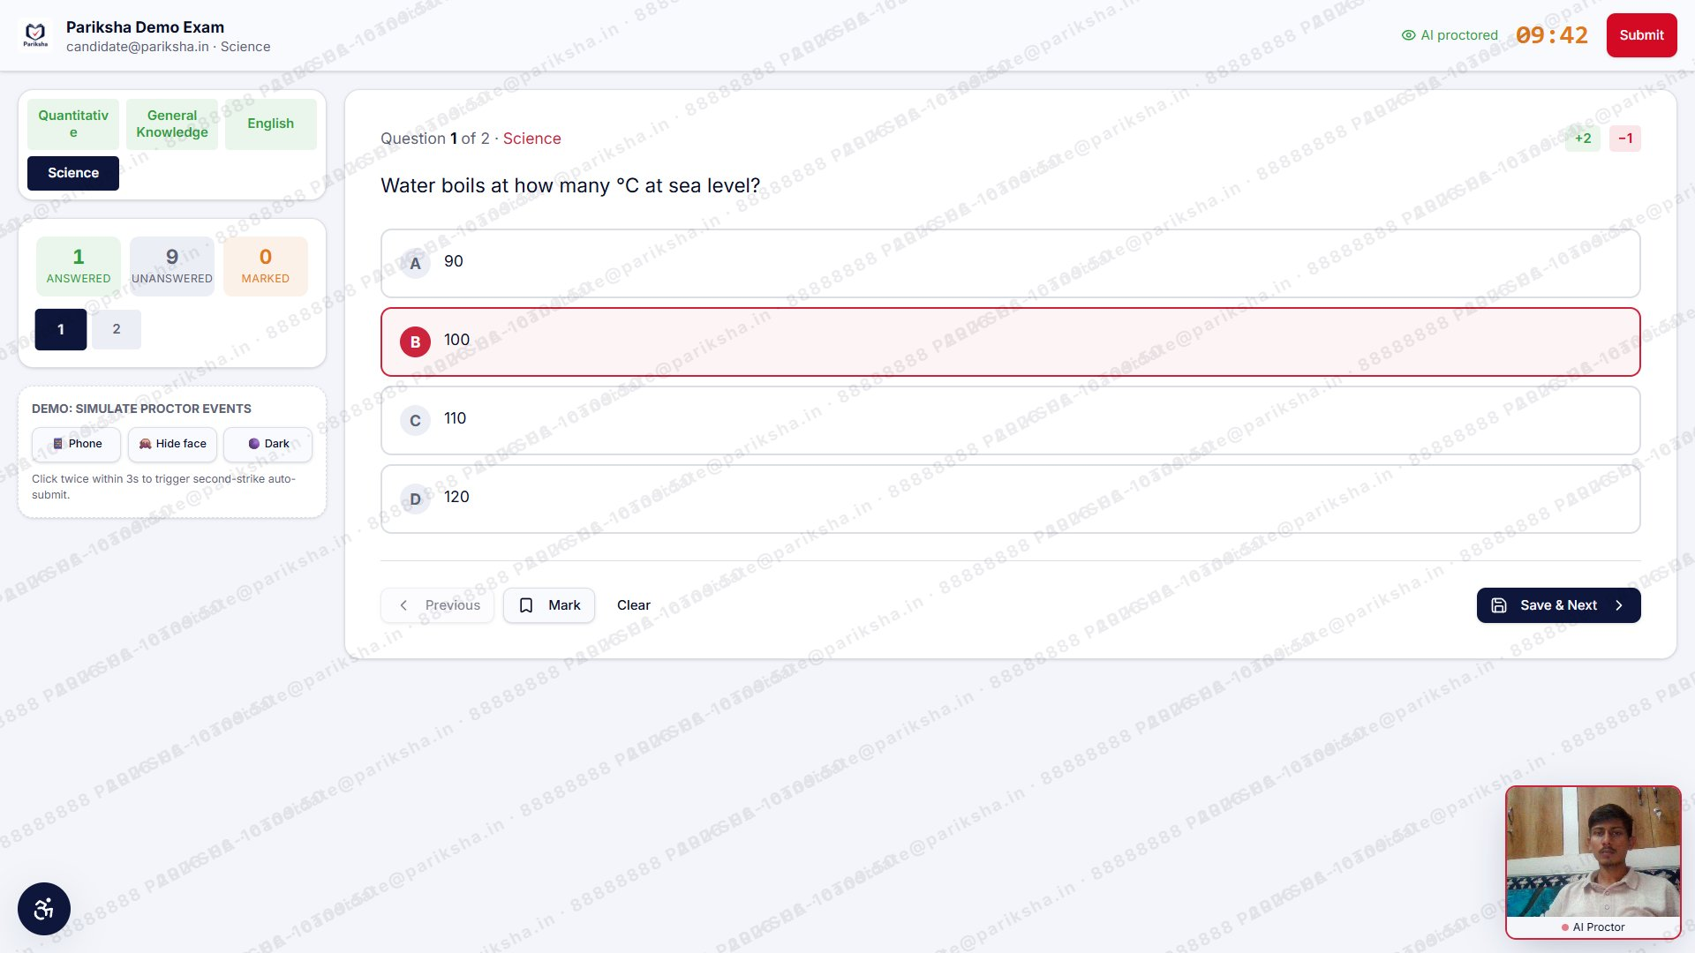





Pariksha
Home
TriShield Vault
Features
Demo
CANDIDATE EXPERIENCE
A lockdown browser — inside the web.
Mandatory fullscreen
Denied = exam blocked. No skip.
Face verify at entry
face-api.js · 70% confidence vs registration photo.
Silent re-check every 5 min
Multiple faces → critical alert, invigilator notified.
3-strike auto-submit
Exit 1 = warn · 2 = alert · 3 = forced submission.
Live integrity score 0–100
WebSocket push. Invigilator sees all, no page refresh.
Live exam — AI proctor bottom-right, watermark anti-leak, section nav left
Also blocked & logged: copy/paste · right-click · F12 · tab-switch · all devtools shortcuts

Slide 9
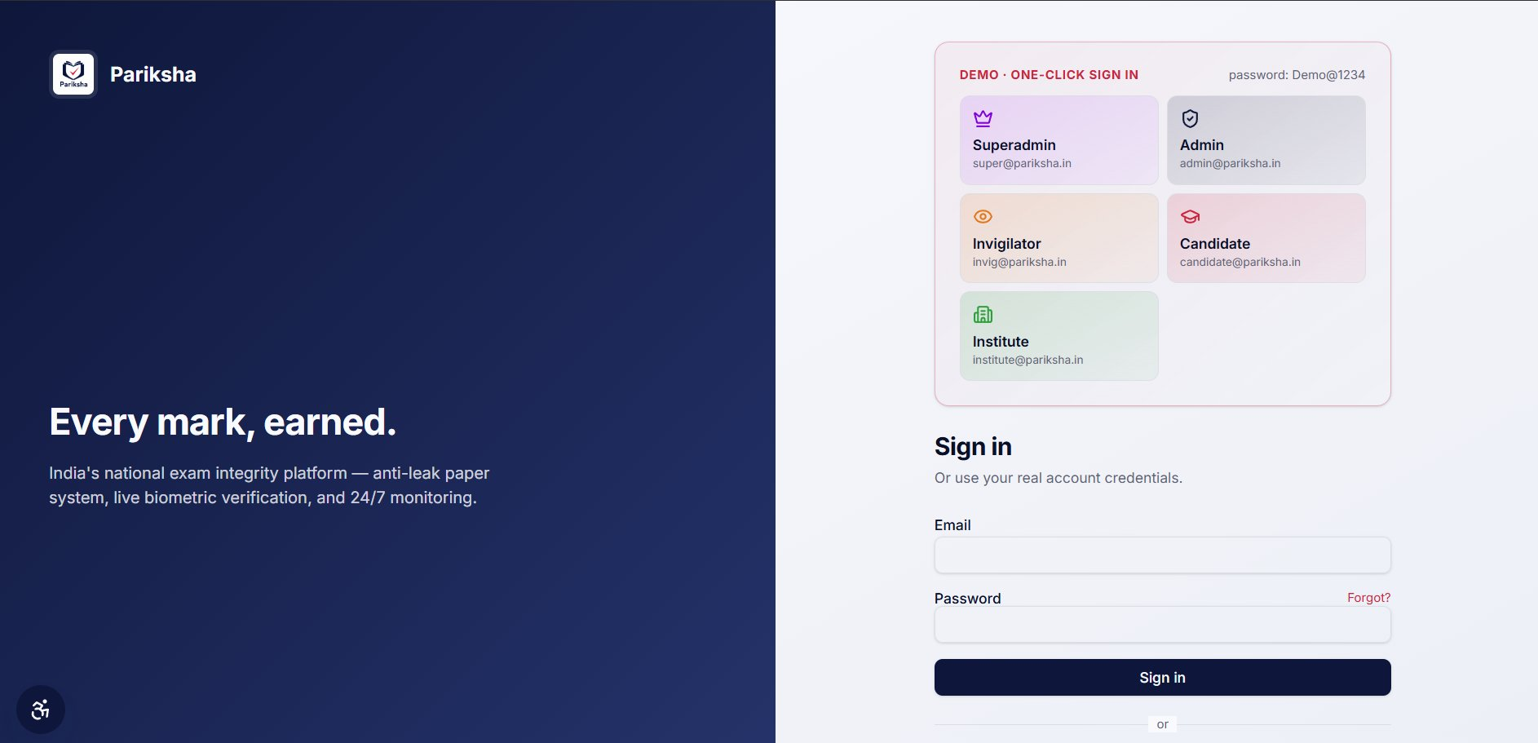
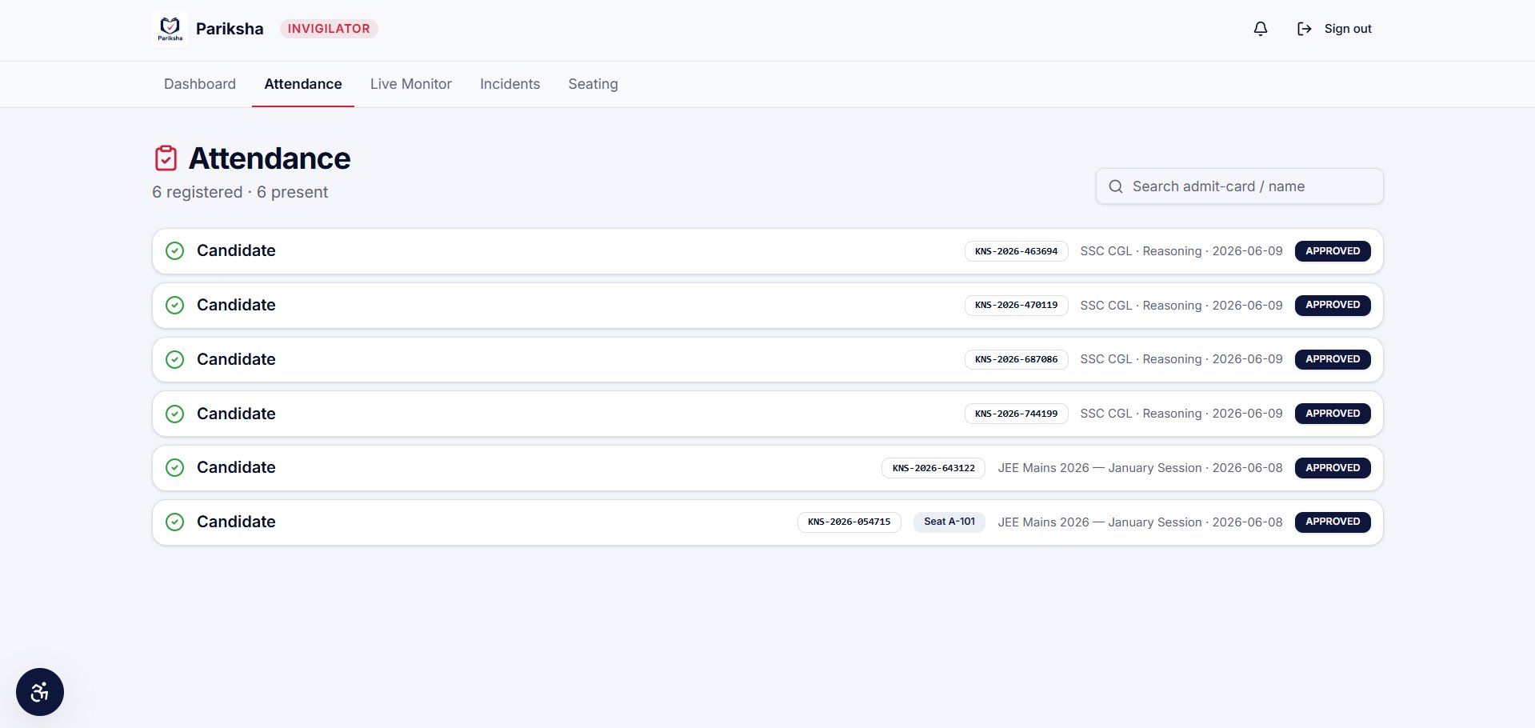
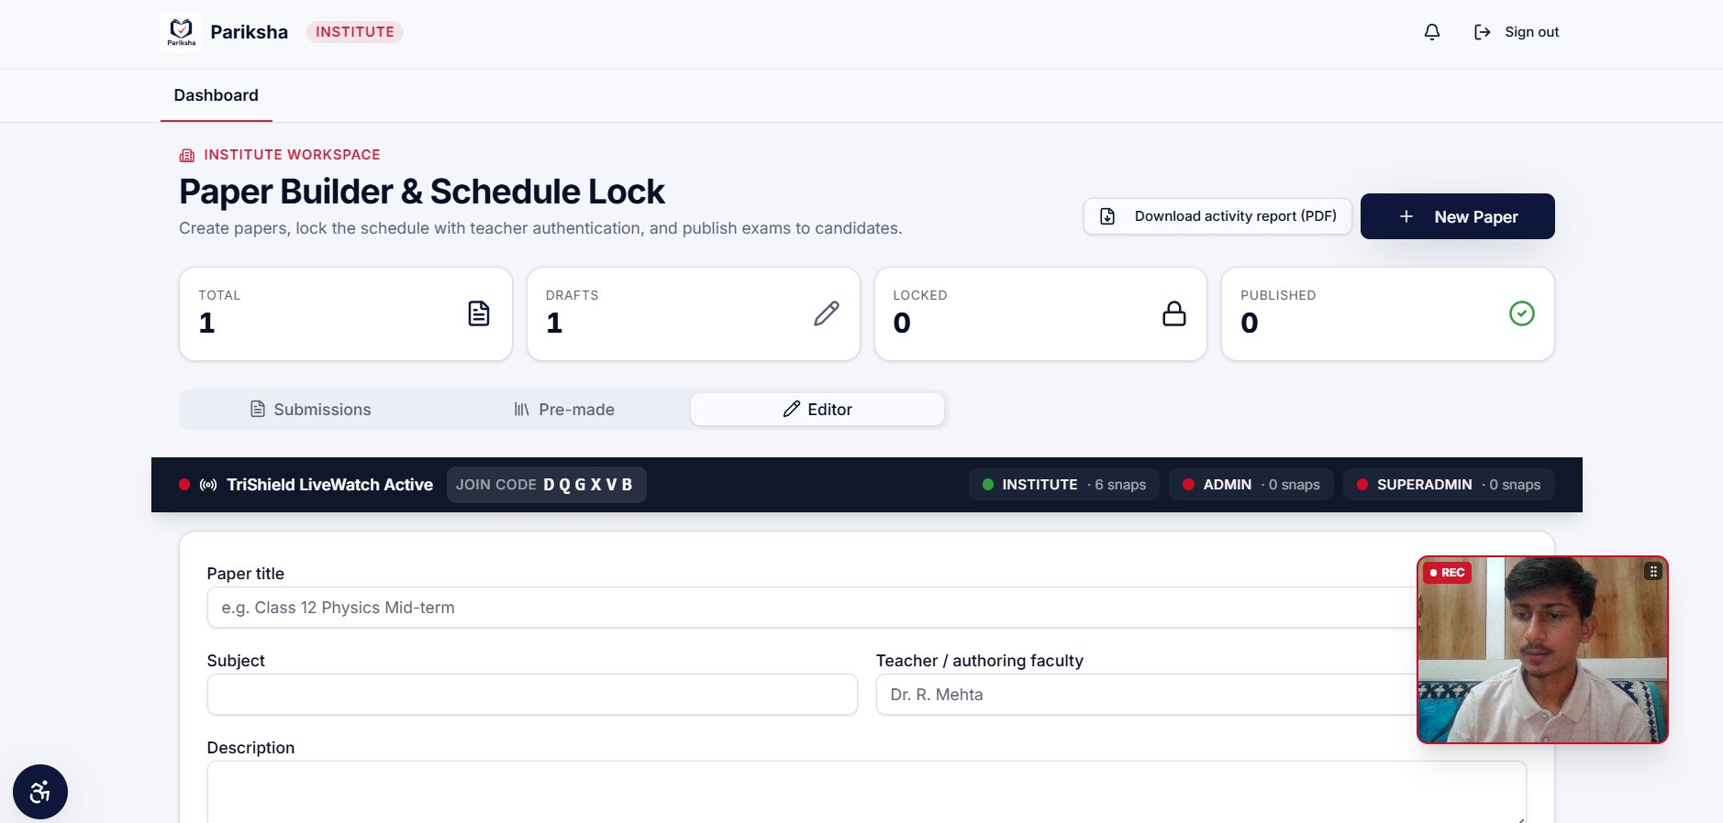
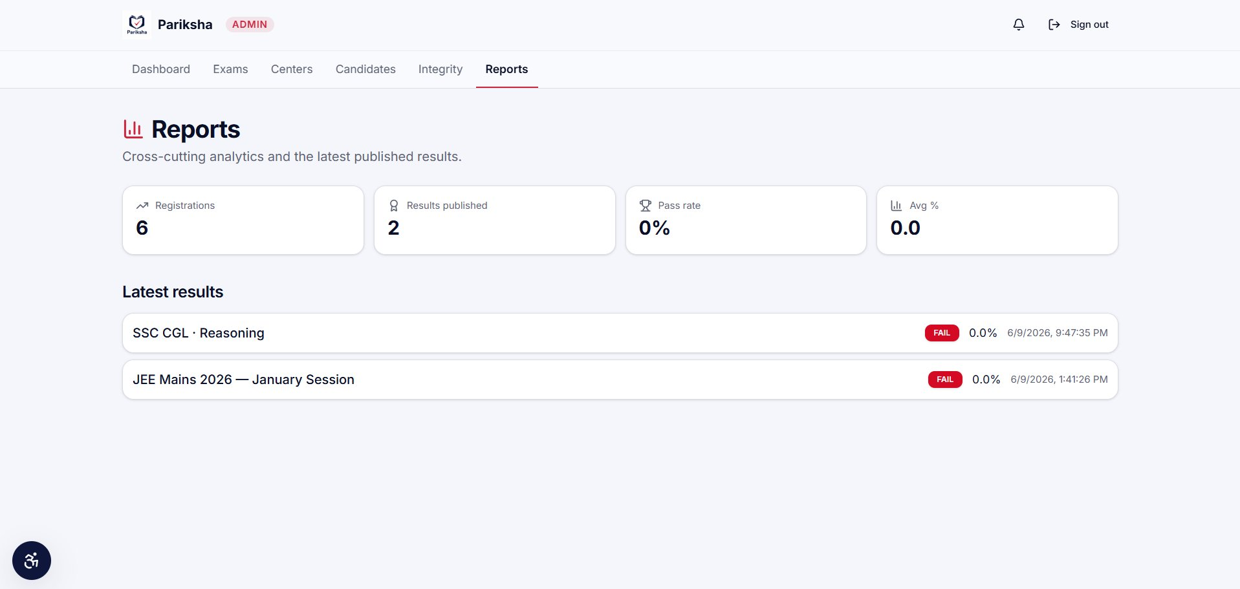
Pariksha
Home
TriShield Vault
Features
Demo
PLATFORM ROLES
Five roles. Every stakeholder covered.
Login — one-click demo cards for all 5 roles (password: Demo@1234)
Invigilator — attendance, 6 candidates all APPROVED, admit-card numbers
Institute — Paper Builder workspace + TriShield LiveWatch active
Admin — Reports dashboard (registrations, pass rate, results)

Slide 10
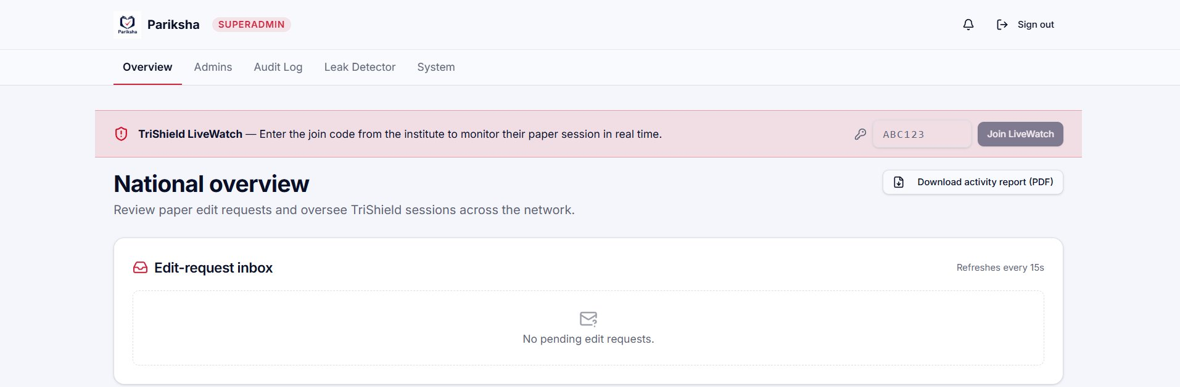
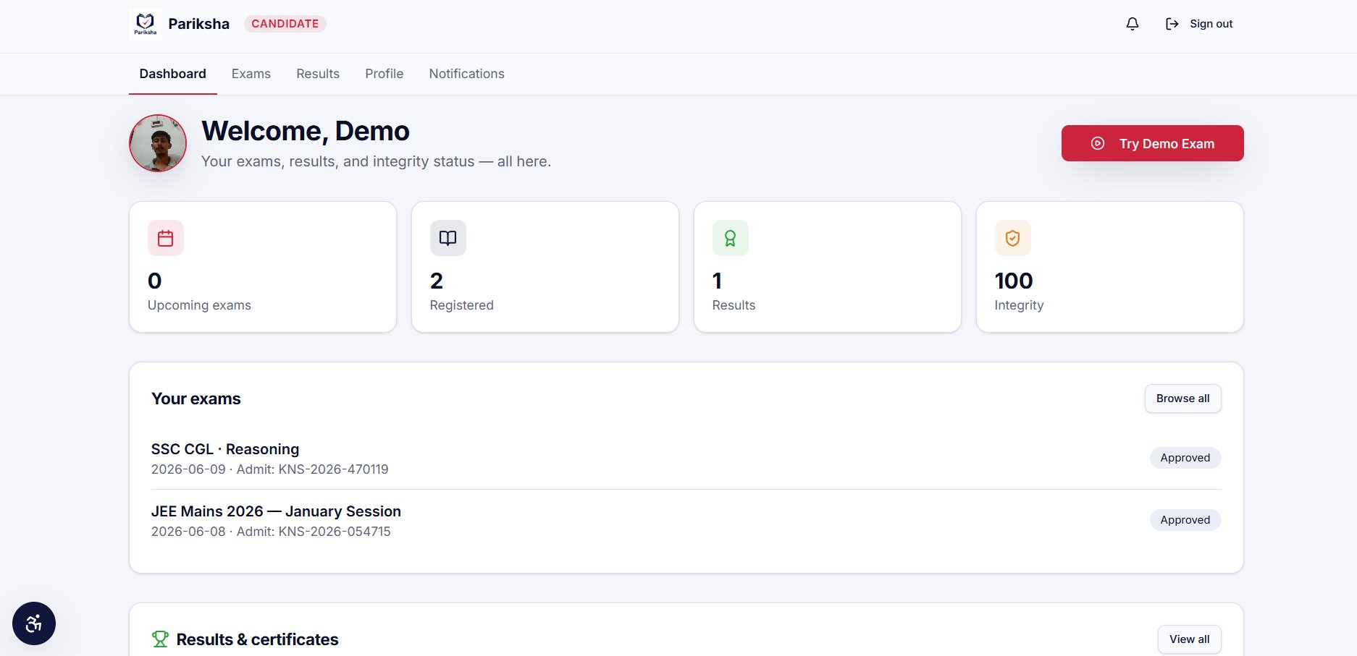
Pariksha
Home
TriShield Vault
Features
Demo
MONITORING
24 × 7. Nothing slips through.
Superadmin — Paper Leak Detector (CRITICAL + HIGH signals from real demo session)
Candidate Dashboard — exams, integrity score (100), results, admit card notifications
60s
0
90d
∞
SHA-256 hash check
interval (Edge Fn)
Paper leaks
since launch
Snapshot retention
DPDP Act 2023
Audit log
never deleted

Slide 11





Pariksha
Home
TriShield Vault
Features
Demo
TECH STACK
Built on the right primitives.
Frontend
Cryptography
React 19 · TanStack Start (SSR) · Vite 7
Tailwind CSS v4 · shadcn/ui · TanStack Query v5
Web Crypto API — AES-256-GCM, SHA-256, PBKDF2
Shamir's Secret Sharing · Ed25519 signatures
Biometrics
Backend
face-api.js (TensorFlow.js)
TinyFaceDetector + FaceLandmark68 + FaceRecognition128
Lovable Cloud (Supabase) — PostgreSQL + RLS
Auth · Realtime WebSocket · 6 Edge Functions
Payments & Output
AI
Razorpay test mode · jsPDF + html2canvas
qrcode npm · Lovable Email Connector
Lovable AI Gateway (Gemini)
Platform Q&A + exam guidance chatbot

Slide 12
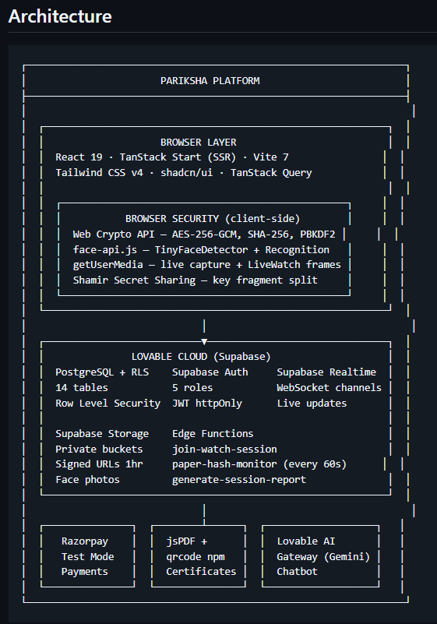

Pariksha
Home
TriShield Vault
Features
Demo
ARCHITECTURE
Clean layers. Every one accountable.
Browser Layer
React 19 · TanStack Start · Vite 7 · Tailwind v4 · shadcn/ui
Web Crypto API (AES-256-GCM, SHA-256, PBKDF2) · face-api.js · Shamir Secret Sharing
All encryption runs entirely client-side — server never sees raw keys
Lovable Cloud (Supabase)
PostgreSQL + Row Level Security — 14 tables, no exceptions · Auth (JWT httpOnly)
Supabase Realtime WebSocket — live events, LiveWatch sync, notification push
6 Edge Functions: paper-hash-monitor (every 60s) · join/end-watch-session · session-report
External Services
Stripe payments · Lovable AI Gateway (Gemini chatbot)
jsPDF + qrcode (certificates, admit cards) · Lovable Email Connector
audit_log — NO DELETE for any role · Aadhaar SHA-256 client-side only · Questions AES-256-GCM only · DPDP Act 2023 compliant

Slide 13
Live Demo Working Video
Three browser tabs. Sixty seconds. End-to-end integrity.
01
Institute tab
Sign in as institute@pariksha.in → Paper Builder → New Paper. Add a question — watch AES-256-GCM encryption run in the browser before request leaves device.
02
Admin tab
Sign in as admin@pariksha.in. Edit-request appears without refreshing (Supabase Realtime push). Approve → 15-min countdown starts on both screens simultaneously.
03
Candidate tab
Sign in as candidate@pariksha.in → Try Demo Exam. Face verification runs. Click Phone / Hide Face → watch invigilator integrity score drop in real time.
04
TriShield Vault
Navigate to /trishield-vault. All 6 steps: Paper Authored → SHA-256 Sealed → AES-256 Encrypted → Time-Locked → Anomaly Watch → Verified Delivery.
Open Platform →
Login (Demo@1234) →
TriShield Vault →
Notes:
BEFORE SUBMITTING: Upload your demo video to Google Drive, set sharing to 'Anyone with link', copy the URL and replace REPLACE_WITH_YOUR_FILE_ID in the red button. Pre-open all 3 tabs before presenting.

Slide 14


Pariksha
Home
TriShield Vault
Features
Demo
FUTURE SCOPE
Phase 1 closes every known attack.
Phase 2 scales to a billion and i want to make it as a new innovative platform for students who suffers always in paper leaks
Aadhaar e-KYC
Blockchain Hashes
Hardware HSM
One-shot verified identity through DigiLocker at registration. No manual document uploads, no fake IDs, no unverified candidates. Government-backed identity confirmation before a student ever reaches the exam.
The SHA-256 hash of every sealed paper is written to Polygon the moment it locks. Public, timestamped, and permanent. Proof that the paper existed unchanged before the exam started.
Fragment 2 moves from an environment variable into a physical Hardware Security Module. Even a full server breach cannot extract the key. Tamper-proof hardware destroys the key if compromised.
Zero-Knowledge Proofs
22 Languages
DigiLocker Certificates
Candidates can verify their paper was not tampered with between sealing and delivery — without the platform revealing a single correct answer. Mathematical proof without exposing the secret.
Every page, every exam, every notification available in all 22 scheduled languages under the Indian constitution. No student excluded because of the language they think and read in.
Pariksha certificates verifiable directly through India's national DigiLocker infrastructure. Universities and employers confirm results without visiting Pariksha. Accepted wherever DigiLocker is accepted.

Slide 15
Pariksha
01
Problem is real — right now.
Every mark, earned.
NEET 2026 cancelled 6 weeks before this submission. 2.27M students. 5 deaths. CBI investigation opened. Supreme Court involved. National news for weeks. This is not a hypothetical problem we chose for a hackathon. It happened while we were building this.
The TriShield Vault
is a new category
of exam security.
02
Architecture is provably better.
No Indian or international authority currently implements simultaneous multi-party key custody for question papers.
This is not an improvement.
It is a structural replacement.
Every documented Indian exam attack vector — insider leak, proxy candidate, database theft, corrupt invigilator — is closed not by adding another layer of monitoring but by eliminating single-party control entirely. One person cannot act alone. That is a mathematical guarantee, not a policy.
03
Live. Not a mockup.
Ketan Rawat · Final-year B.Tech ECE
NIT Jamshedpur
Five working roles with one-click demo login. Real Stripe payments. Real face verification. Real encrypted papers. Real PDFs with Ed25519 signatures. Real-time WebSocket integrity monitoring. TriShield 6-step demo completes in under 60 seconds with three live browser sessions on a real database.
pariksha-platform.lovable.app
GitHub →
FAR AWAY 2026 · Innovation · Impact · Technical Depth · Completeness

